Slide 1

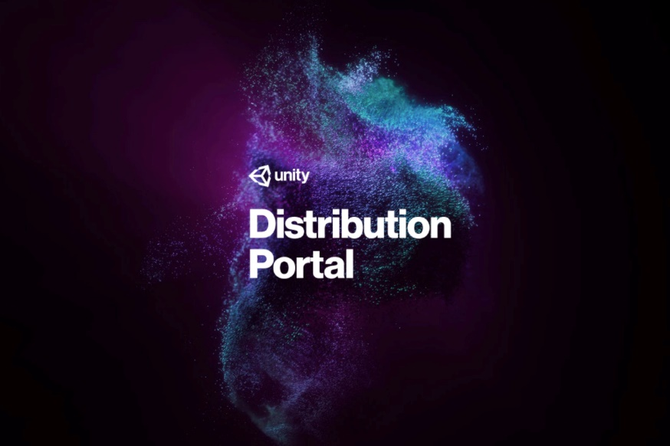
HUAWEI Mobile Services
Unity Game Integration
Solution Overview
Oct 2020
Mustafa CAN

Slide 2

How to Integrate Unity Games into HMS?
Unity games has 4 different option to integrate into HMS ecosystem.
Unity Distribution Portal (UDP)
HMS Unity Plugin
Unity Asset Store
Manual – Toolkit
UDP is an official product and centralized platform of Unity that allows developers to integrate particular capabilities from different providers to their games and release their games to multiple app stores. Unity is officially developing, maintaining and providing support to Unity developers
HMS Unity Plugin is an open source and community driven project that allows game developers to utilize Huawei Mobile Services in games. This plugin reflects rich world of HMS to unity and provides seamless integration for developers. Experts of Huawei are also contributing on this open source project
Unity Asset Store Unity Asset Store is another add-on service officially developed and maintained by Unity. Developers may utilize Unity Asset Store alone or together with UDP.
Manual – Toolkit is another option but it is toughest one. With this approach, developers can create the HMS – Unity bridges by themselves which may give them the best control over the integration. HMS Toolkit can also be utilized.

Slide 3








Unity Based Game Integration
 | IAP | Ads | Account | Game Service | Push | Analytics | Location | Crash
Unity Distribution Portal(*) | ✓ | ✓(****) | ✓
HMS Unity Plugin(**) | ✓ | ✓ | ✓ | ✓ | ✓ | ✓ |  | ✓
Unity Asset Store(***) | - | ✓ | ✓ | ✓ | ✓ | ✓ | ✓
Manual or Toolkit | ✓ | ✓ | ✓ | ✓ | ✓ | ✓ | ✓ | ✓
(*) https://distribute.dashboard.unity.com/udp/partners/HuaweiAppGallery
(**) https://github.com/EvilMindDevs/hms-unity-plugin
(***) https://assetstore.unity.com/packages/add-ons/services/huawei-hms-core-app-services-176968
(****) UDP does not uses Huawei Ads Kit. Its selected because UDP has its own 3rd party Ads Service
Note: You can integrate IAP with Unity IAP too https://docs.unity3d.com/Manual/UnityIAP.html

Slide 4
Docs to Learn More
Kit or Functions | Documentation
Registration and Verification Guide | https://developer.huawei.com/consumer/en/devservice/doc/10104
Plugin Account Kit Example | https://medium.com/huawei-developers/importance-of-huawei-account-kit-for-unity-and-integration-5c9840eda649
Plugin IAP Demo | https://github.com/MustafaCQN/HmsUnityIAP
Plugin IAP Demo2 | https://github.com/gmYusuf/HMSUnityIAP
UDP Docs | https://docs.unity3d.com/Packages/com.unity.purchasing.udp@2.0/manual/index.html
UDP Services Questions | https://support.unity3d.com/hc/en-us/categories/200417079-Services?_ga=2.93668436.838580282.1601469540-71103090.1592303159
Huawei Developer Forum | https://forums.developer.huawei.com/forumPortal/en/home
UDP Guide – Using Huawei AppGallery | https://distribute.dashboard.unity.com/udp/guideDoc/HUAWEI
UDP whole process as Youtube Video | https://www.youtube.com/watch?v=5QiXMcPVH_M&feature=youtu.be&ab_channel=RobertMay

Slide 5
Unity Integration Proposals
Proposal | Document
HMS Integration UDP Proposal Template_V2.2
HMS Integration Unity Plugin Proposal Template_V2.1

Slide 6
THANK YOU

